Slide 1

BLOOD DONOR PROBLEM
ASHISH JHA
RUPABH BHARTI
HARKISHAN KAUSHIK

Slide 2

Content
Introduction
Problem
Implementation
Gale Shapley Algorithm
Solution
Conclusion

Slide 3
Introduction
Many people suffer from blood loss due to some accident or other misfortunes and need blood transplant.
A healthy person can donate blood every three months. This creates the possibility of many blood donors, mostly a family member of the patient in need of same blood group.
For example, a patient with O blood type can only receive blood from a donor with the same blood type, and similarly an AB donor can only donate to an AB patient.

Slide 4
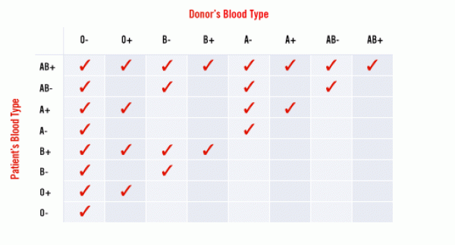
Blood group types
Source: WHO

Slide 5
Implementation
We devised a code implementing Gale Shapley Algorithm to find suitable matches for every patient with donors having their respective blood groups.
We consider two sets — the “patient” and “donor” — with finite vertices. Each vertex also has a total ordering over the vertices of the other set.

Slide 6
Gale Shapley Algorithm
The Gale Shapley Algorithm is devised by David Gale and Lloyd Shapley in 1962 to solve the stable matching problem.
The Stable Matching Problem is the problem of finding a stable matching between two equally sized sets of elements given an ordering of preferences for each element.

Slide 7
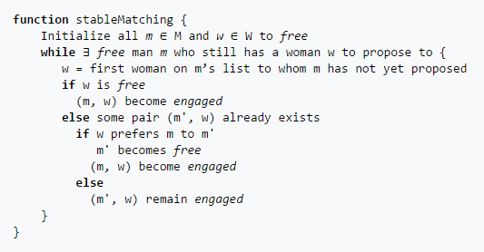
Gale Shapley Algorithm

Slide 8
Solution
Each patient has a preference list that strictly orders all members of the donors.
If a patient P prefers d1 to d2, we write d1 >p d2. A similar notation is used for donor’s preferences.
A matching M of I is a set of disjoint patient-donor pairs of I.
If in a matching M, a patient P and a donor d are matched together, we write M(p) = d and M(d) = p.

Slide 9
Every patient has it’s own priority list of donors and vice versa.
A donor always donates to the first patient he/she matches with.
As long as the patient is free he approaches next donor.
A donor accepts if the match is better than the current one.
It continues till every patient is matched with a donor.

Slide 10
Assume patients are named P1 , P2 , P3 , P4.
Assume donors are named D1 , D2 , D3 , D4.
A python implementation of the said algorithm follows.
We then applied the stable matching algorithm mentioned above in the report.
We have made two hash-maps, one holding information of patient’s preference and one holding information of donor’s preference where name of donor/patient is key and his preference is the value.

Slide 11
The main() function calls the stable_matching() function and it in turns calls the begin_matching() function to start with the main proceedings of the program.
The begin_matching() function is the heart of the program which applies the gale-shapley algorithm to match each patient with their respective donor.
The begin_matching() function runs till we have zero patients unmatched with their respective stable donors.
Finally we get a list of stably matched patients with their respective donors.

Slide 12
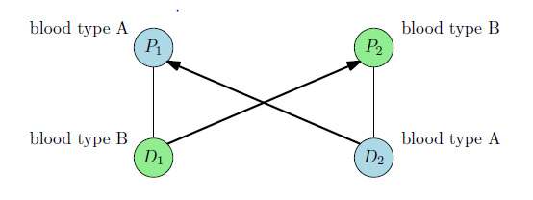
CONCLUSION
We have explored some results on the stable marriage problem and many of its variants.

Slide 13
THANK YOU

